Slide 1
Food Delivery App Sentimental Analysis
B.Vinaykrishna
R.Lingeswaran
N.Soundar

Slide 2
What is Business Analytics?
Business analytics is essentially the use of data to improve business decision-making.
It involves collecting and analyzing information from various sources to uncover trends, patterns, and insights that can help businesses operate more efficiently and profitably.
Key aspects:
Data collection and processing
Data analysis
Data analysis
Data visualization
Predictive analytics

Slide 3
Power BI
Power BI is a collection of tools from Microsoft that lets you turn data from various sources into visually appealing and interactive insights. Imagine it as a business intelligence (BI) platform that helps you analyze and understand your data to make better decisions.

Slide 4
Abstract of the project
This project outlines the development of a Power BI dashboard to analyze customer sentiment towards food delivery apps. By leveraging customer reviews and sentiment analysis, the dashboard provides valuable insights for app companies.
Data: Customer reviews containing text and ratings are analyzed. Sentiment analysis categorizes these reviews as positive, negative, or neutral.
Dashboard Design: Visualizations display overall sentiment, sentiment by app, trending themes, and the relationship between sentiment and ratings. Users can filter by app, timeframe, or keywords for a deeper dive.
Benefits: The dashboard helps app companies understand customer satisfaction, identify areas for improvement, compare competitor performance, and track sentiment over time. This empowers data-driven decision making to enhance customer experience and gain a competitive edge.
Tools: Power BI Desktop facilitates data import, transformation, visualization, and sentiment analysis using built-in tools or external APIs.

Slide 5
Key Components
Sentiment Breakdown: Visualize the overall sentiment distribution across all apps (positive, negative, neutral).
App Comparison: Compare sentiment trends for individual food delivery apps.
Thematic Analysis: Identify key themes through word clouds for positive and negative reviews.
Sentiment Trends: Track sentiment changes over time (monthly, quarterly) to gauge user perception.
Review Exploration: Allow users to drill down and explore sample reviews categorized by sentiment for specific apps.
Benefits:
Improved Customer Experience: Identify areas for improvement based on customer feedback.
Data-Driven Decisions: Track sentiment trends to measure the impact of changes or campaigns.
Competitive Advantage: Benchmark against competitor apps and identify areas for differentiation.
Tools:
Power BI Desktop: The primary platform for building the interactive dashboard with insightful visualizations.
Sentiment Analysis: Leverage Power BI's built-in capabilities or integrate with external APIs

Slide 6
Dashboard Design
The dashboard should provide insights into customer sentiment towards various aspects of food delivery apps. Here are some suggested visualizations:
1. Overall Sentiment:
A pie chart or donut chart displaying the distribution of positive, negative, and neutral reviews across all apps.
2. Sentiment by App:
A bar chart comparing the percentage of positive, negative, and neutral reviews for each food delivery app.
3. Word Cloud:
A word cloud highlighting the most frequently used words in positive and negative reviews, allowing for quick identification of key themes.
4. Sentiment Over Time:
A line chart showing how sentiment towards each app changes over time (monthly, quarterly).
5. Reviews by Rating:
A scatter plot or table visualizing the relationship between sentiment score and numerical rating provided by the customer.

Slide 7
Tools and Techniques
Power BI Desktop: This is the primary tool for building the dashboard.
Data Import and Transformation: Kaggle dataset (Product.xlsx) and (SalesData.xlsx)
Sentiment Analysis: Utilize Power BI's built-in sentiment analysis or integrate with external sentiment analysis APIs.
Data Visualization: Utilize Power BI's extensive library of charts and graphs to create insightful visualizations.

Slide 8
Benefits
This dashboard will provide valuable insights for food delivery app companies, such as:
* Understanding customer satisfaction with different aspects of the service (delivery speed, restaurant selection, customer support).
* Identifying areas for improvement based on negative sentiment.
* Comparing performance against competitor apps.
* Tracking sentiment over time to measure the impact of changes or campaigns.

Slide 9
Future Enhancements
Integration with social media data to capture a broader spectrum of customer sentiment.
Sentiment analysis by category (e.g., delivery speed, restaurant selection) for more granular insights.
Advanced machine learning techniques for predicting future sentiment trends.

Slide 10
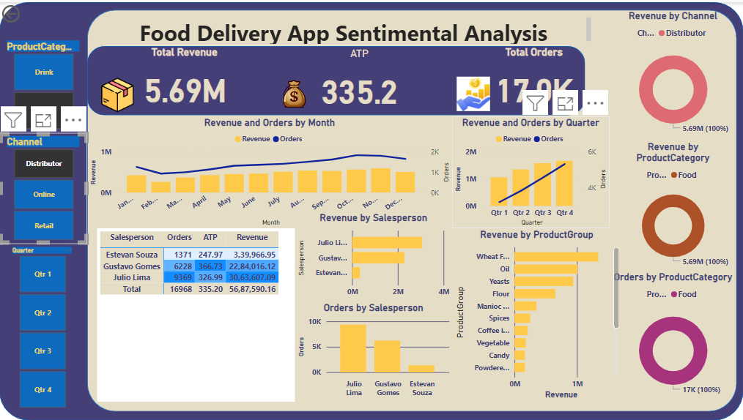
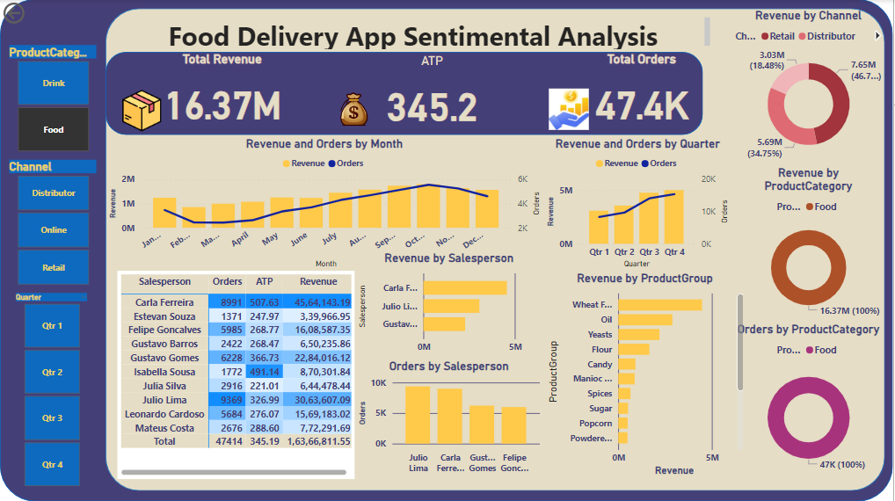
Output

